Slide 1
Employment performance
Presenting By
K AYUSHA RAJ
PGDA 26
Koramangala, Bangalore

Slide 2
Table of Contents
Problem statement
Data Description
Key findings
Model Comparison

Slide 3
Problem Statement
The problem statement is that what all factors affect the overall productivity of the garment factory company.
This dataset includes important attributes of the garment manufacturing process and the productivity of the employees which had been collected manually and also been validated by the industry experts.

Slide 4
Data Preprocessing
The wip (work in progress) has 423 null values and need to be treated.
The null values are been treated by filling the null values by the mean if the work in progress dataset.
Check weather the data is normally distributed or skewed.
There are not extreme outliers can be handled by the model itself.

Slide 5
Data Description
The dataset is extracted from Kaggle
Dataset link : https://www.kaggle.com/code/ayusharaj/employment-performance
Employment performance prediction is a Regression problem.
The volume of the dataset is 1017 samples and 26 features.
There are 26 continuous variables.
Variables:- team, targeted_productivity, smv, wip, over_time, incentive, idle_time, idle_men, no_of_style_change, no_of_workers, month, quarter_Quarter1, quarter_Quarter2, quarter_Quarter3, quarter_Quarter4, quarter_Quarter5, department_finishing, department_sweing, day_Monday, day_Saturday, day_Sunday, day_Thursday, day_Tuesday, day_Wednesday, actual_productivity.
Target variable is actual productivity.

Slide 6
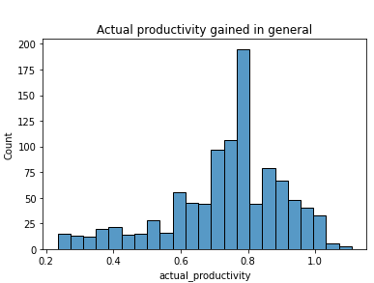
Key Findings
After the pre-processing of the dataset and replacement of the null values the target variable is normally distributed

Slide 7
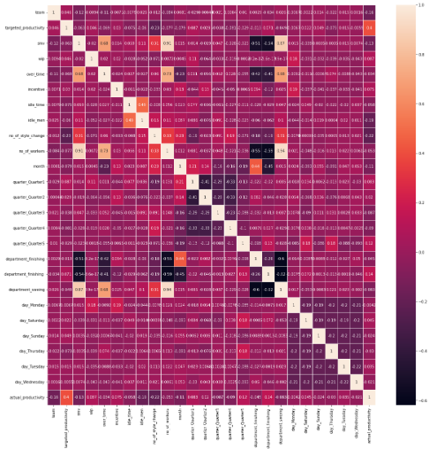
Key Findings
Correlation matrix

Slide 8
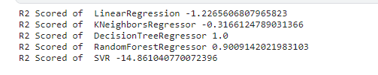
Model Summary
R2 score showed the following order of models as per their effectiveness.
Decision Tree Regressor (1.0) > RandomForestRegressor 0.90 >KNeighborsRegressor -0.34 > KNeighborsRegressor -0.34

Slide 9
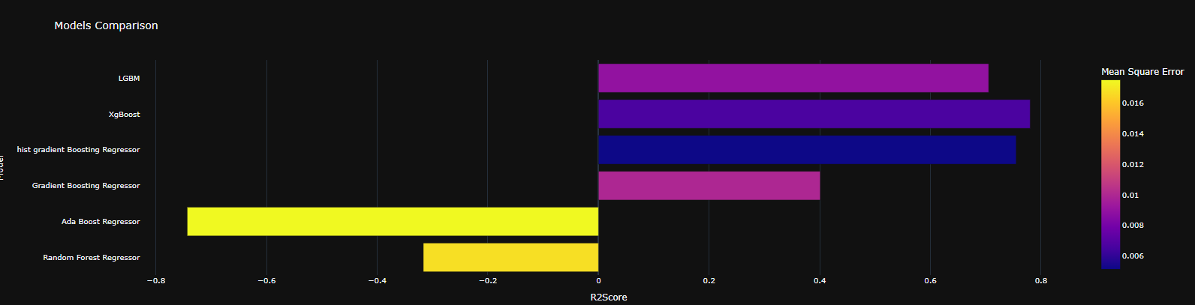
Model Summary
XG Boost was found to be the most efficient of all the other models we explored so far.
Hist gradient boosting regressor > LGBM > Gradient boosting model.

Slide 10
Thank You

